Slide 1
Using the Cluster

Slide 2
Learning outcomes
Learn how to submit jobs on a shared system
get an overview of the cluster and its architecture
learn about job scheduling and queues
learn how to write simple shell scripts
try different job types: single, multi-core, and fully parallel

Slide 3
HPC overview
user’s desktop
connect to cluster (SSH)
shared
storage
head node
n1
n2
n3
n4
worker/child/compute nodes
all nodes are running the Linux distribution known as Rocky Linux (version 8.x)

Slide 4

HPC overview
48x 64 core PowerEdge C6420
2x 16 core (32T) Xeon Silver 4216 @ 2.1Ghz
192 GB RAM; 1.5 TB SSD cache
1x 128 core PowerEdge R940xa
4x 16 core (32T) Xeon Gold 6242 @ 2.8Ghz
3 TB RAM; 1.5 TB SSD cache
2x Nvidia Tesla V100 32GB GPU
6x 48-54 core PowerEdge R630/R640/R740
1 with 1.5 TB RAM
1 with Nvidia Tesla V100 16GB GPU
1x 32 core PowerEdge R7525
2x 8 core (16T) EPYC 7252 @ 3.1Ghz
256 GB RAM; 0.5 TB SSD cache
2x Nvidia Quadro RTX 8000 48GB GPUs
1x 128 core PowerEdge R7525
2x 32 core (64T) EPYC 7202 @ 2.5Ghz
2 TB RAM; 0.75 TB SSD cache
…OUT OF DATE…

Slide 5
HPC overview
user’s desktop
shared
storage
connect to cluster (SSH)
head node
n1
n2
n3
n4
n5
n6
n7
n8
n9
n10
n11
n12
n13
n14
n15
n16
n17
n18
n19
n20
n21
n22
n23
n24
n25
n26
n27
n28
n29
n30
n31
n32
n33
n34
n35
n36
n37
n38
n39
n40
n41
n42
n43
n44
n45
n46
n47
n48
n49
n50
n51
n52
n53
n54
n55
n56

Slide 6
Counting CPUs
n1
CPU #1
CPU #2
CPU #1
CPU #2

Slide 7

Slurm overview
Slurm is a job scheduler for cluster computing, providing:
job submission and automatic execution
job monitoring and control
resource management
priority management
…
At the most basic level, you put the commands you want to run into a script file, submit that script to the cluster’s queue (of jobs), and Slurm will then select a node for it to run on once it reaches the front of the queue
we’ll talk more about scripts and queues later

Slide 8
HPC and Slurm
user’s desktop
connect to cluster (SSH)
shared
storage
head node
n1
n2
n3
n4
worker/child/compute nodes

Slide 9
HPC and Slurm
user’s desktop
connect to cluster (SSH)
shared
storage
head node
submit job
Slurm
n1
n2
n3
n4
job dispatched to (one or more) worker nodes

Slide 10
HPC and Slurm
user’s desktop
connect to cluster (SSH)
shared
storage
head node
don’t run jobs here
submit job
Slurm
n1
n2
n3
n4
do run jobs here
job dispatched to (one or more) worker nodes

Slide 11
Slurm job types
Slurm recognizes several basic classes of job:
interactive jobs
single or multicore
batch jobs
single or multicore
array jobs (eg “embarrassingly parallel”)
parallel jobs (eg MPI)
Let’s start by looking at the first type; interactive:
simply provides the user with an interactive login to an available resource in the compute cluster

Slide 12
Activity: interactive jobs
Once logged onto the head node, issue the following command:
This will schedule you a single slot on the cluster, and transfer you to an interactive (worker node) shell
ideal for running interactive programs like R or for running long compile jobs
To exit back to the head node, type exit or press CTRL+D
$ srsh -p debug
Never use the head node for running jobs – we’ll discuss why later

Slide 13
The Linux shell
The command-line interface you’ve been using is known as a Linux shell:
in this case, Bash
The shell is just an interface between the user and the Linux kernel for executing commands
But with support for powerful features:
wildcards, piping, variables, loops, condition-testing, history, aliases, job control, etc…

Slide 14
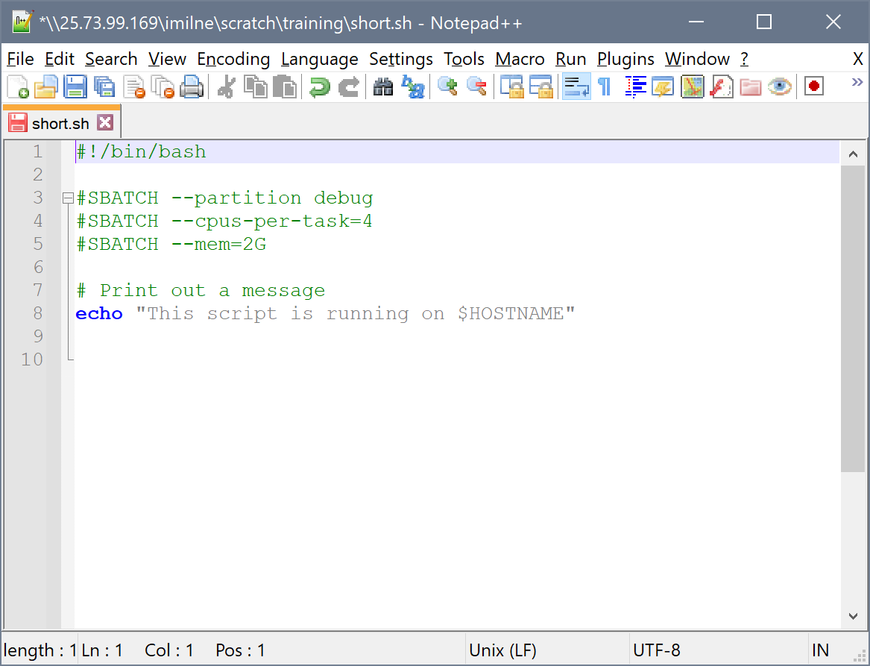
Shell scripts
A shell script is simply a file containing one or more commands batched together, eg:
change to a directory…
execute a program on this data…
now feed that data into this second program…
One of the easiest ways of working with the cluster is to prepare what you want to run in a script, and then submit that to Slurm

Slide 15
Activity: running a basic script
Using nano, create a new text file in your scratch/training folder called script.sh
Now edit script.sh to contain:
#!/bin/bash
# Print out a message
echo "This script is running on $(hostname)"

Slide 16
Activity: running a basic script
Run the script with:
$ sh script.sh

Slide 17
Activity: running a basic script
What does this script do?
The first line lets the system know it’s a Bash script
Lines beginning with a # are comments
The echo command prints text to the display
$(hostname) is running a command to capture the name of the machine the script runs on
#!/bin/bash
# Print out a message
echo "This script is running on $(hostname)"

Slide 18
Queues (“partitions”)
Jobs are scheduled by submitting them to a specified queue
the queue is where jobs wait and where they run
Although jobs can be submitted to the queue from any node, it’s recommended to only use the head node for this purpose
QUEUE | CPUS | RAM (GB) | TIME LIMIT
short | 640 | 192-512 | 6 hrs
medium | 1,152 | 192-512 | 24 hrs
long | 1,888 | 192-512 | 14 days
himem | 440 | 1500-4000 | 14 days
gpu | 336 | 192-512 | 14 days

Slide 19

At the Post Office
n1
n2
n3
n4

Slide 20
At the Post Office
n1
n2
n3
n4

Slide 21
At the Post Office
n1
n2
n3
n4

Slide 22
Activity: batch jobs
We’ll need to use the debug queue to ensure capacity during training
We can submit our script to the queue using the sbatch command:
This type of job is an example of an Slurm batch job
because it will be queued and may not run straight away
$ sbatch -p debug script.sh
Submitted batch job 602552

Slide 23
Activity: batch jobs
Any output and error information that would normally have been printed to the screen is merged together into a file named using the job’s ID (slurm-<jobID>.out) but you can override this behaviour using the --output and --error parameters.
$ more slurm-602552.out
This script is running on n19-04-008-cortana.hpc.hutton.ac.uk

Slide 24
Slurm options
Options are provided to Slurm using the #SBATCH prefix
Can be used to fine-control every aspect of a job:
where the output files are created
request nodes with specific features (eg high memory or copies of licensed software)
give jobs a friendly name
email the user when a job starts or ends
control parallelization (multicore, array, or MPI jobs)
Run man sbatch for more information

Slide 25
Activity: Slurm options
#!/bin/bash
#SBATCH --partition=debug
#SBATCH --cpus-per-task=4
#SBATCH --mem=16G
#SBATCH --job-name="test job"
#SBATCH --mail-user=email@address.com
#SBATCH --mail-type=END,FAIL
# Print out a message
echo "This script is running on $(hostname)"
echo "CPUs available: $SLURM_CPUS_PER_TASK"

Slide 26
Activity: slowing things down
The sleep command will delay execution for the specified amount of time:
#!/bin/bash
#SBATCH --partition=debug
#SBATCH --cpus-per-task=4
#SBATCH --mem=16G
#SBATCH --job-name="test job"
#SBATCH --mail-user=email@address.com
#SBATCH --mail-type=END,FAIL
# Print out a message
echo "This script is running on $(hostname)"
echo "CPUs available: $SLURM_CPUS_PER_TASK"
sleep 30m

Slide 27
Activity: monitoring the queue
See the queue and what’s running:
$ squeue
JOBID PARTITION NAME USER ST TIME NODES NODELIST(REASON)
604152 gpu paleomix tmichel PD 0:00 1 (Resources)
602526 medium bash mschreib R 5:36:45 1 n19-32-192-doctorstrange
591581 himem bash pribeca R 6-10:57:12 1 n17-28-1536-apollo
601905 gpu pacasus. marmstro R 16:22:18 1 n19-24-192-jaws
601903 gpu pacasus. marmstro R 16:23:54 1 n19-64-3072-thanos
601907 gpu pacasus. marmstro R 7:58:48 1 n19-64-3072-thanos
600978 medium raxml_ge whuang R 22:59:20 1 n19-32-192-doctorstrange
591513 long BGB msreenat R 6-12:58:02 1 n19-32-192-wintersoldier
591484 long BGB msreenat R 6-13:40:45 1 n19-32-192-wintersoldier
591478 long BGB msreenat R 6-13:48:24 1 n19-32-192-whiplash
602585 medium bash kleempoe R 2:48:47 1 n19-32-192-hela
Notes:
The queue has 144 slots – one per CPU available
Once each slot is full, then jobs must wait in the queue

Slide 28
Activity: Cancelling jobs
A long running job can be cancelled by providing the scancel command with its Job ID:
You can also cancel all your jobs with the -u (user) option:
You can only cancel your own jobs, so no need to worry (too much) about getting the ID wrong
$ scancel 12345
$ scancel -u username

Slide 29
Interlude - Bioconda

Slide 30
Installing software
There are many options for installing software:
already installed system-wide (admins only)
download an x86-64 binary
compile from source
use a package manager
build a containerized environment

Slide 31

Bioconda
For bioinformatics, we can use Bioconda
more than 7,000 packages available
Bioconda deals with any dependencies
doesn’t require root
doesn’t clash with system (or another user’s) packages
lots more info at https://bioconda.github.io/

Slide 32
Activity: Installing Bioconda
Although you could install Bioconda manually, we have automated the process to optimize disk usage for our setup:
By default, Bioconda on gruffalo searches for packages from:
bioconda, conda-forge, and R
#!/bin/bash
#SBATCH --partition=debug
#SBATCH --mem=8G
#SBATCH --job-name="conda"
#SBATCH --mail-user=email@address.com
#SBATCH --mail-type=END,FAIL
install-bioconda

Slide 33

Parallel processing
Since the advent of the multi-core processor, many programs have been written (or rewritten) to run on more than one CPU core at a time
Depending on the task, this can give a near-linear speedup in performance as the number of CPU cores increases
Let’s look at an example now where we can use multiple cores at once…

Slide 34
Compressing files
It’s usually a good idea to compress files to save disk space and reduce network load when transferring them around
On Linux, this is usually via gzip compression:
similar to zip, but for single rather than multiple files
uses the .gz extension
extremely efficient with text files (eg sequence data) with savings of up to 60-70%

Slide 35
Activity: compressing files
cd to ~/scratch/training/data and make a new script:
Submit to Slurm, and you should end up with raspberry.fasta.gz, approximately 1/3rd of the size of the original
#!/bin/bash
#SBATCH --partition=debug
#SBATCH --cpus-per-task=4
pigz -k -f raspberry.fasta
Notes:
Job stats on 1v4 cpus could be interesting; total CPU time is the same, but wallclock differs

Slide 36
Multiple multi-core jobs
Here we have 4x jobs each using 4x cores
CPU #1 16C (32T)
X | X | X | X | X | X | X | X
CPU #2 16C (32T)
X | X | X | X
CPU #3 16C (32T)
 |  |  |  | X | X | X | X
CPU #4 16C (32T)

Slide 37
Bash arrays
A bash array is a collection of elements or values that can be stored in a single variable
$ myArray=(value1 value2 value3)
$ echo ${myArray[0]}
value1
$ echo ${myArray[1]}
value2
$ echo ${myArray[2]}
value3

Slide 38
Bash arrays
An array can be used to quickly reference all the files in a folder
$ FILES=(*.fasta)
$ echo ${FILES[0]}
CAACVU01.fasta
$ echo ${FILES[1]}
CM016664.1.fasta
$ echo ${FILES[2]}
ena_embl_20210317-1411.fasta

Slide 39
Bash arrays
Arrays are incredibly powerful:
store multiple elements of the same data type in a single variable
easier to manage and manipulate large sets of data, with cleaner code
perform operations on all elements in the array using loops or other control structures

Slide 40
Array (parallel) jobs
Job [12345]
task 1
Compress a file
{ compresses aaa.fasta }
task 2
Compress a file
{ compresses bbb.fasta }
task 3
Compress a file
{ compresses ccc.fasta }
task 4
Compress a file
{ compresses ddd.fasta }
task 5
Compress a file
{ compresses eee.fasta }

Slide 41
Array (parallel) jobs
An array job is one in which the submitted script is run multiple times
They consist of a series of tasks that can all be run in parallel, but are completely independent of one another
the tasks’ actions are identical except for the data sets on which they operate
Each task is distinguished by the value $SLURM_ARRAY_TASK_ID
in an array job with 10 tasks, $SLURM_ARRAY_TASK_ID will be 1 in the first instance, 2 in the second, and so on up to 10
The important thing to remember is that the same script is used for each and every iteration

Slide 42
Activity: array jobs
#!/bin/bash
#SBATCH --partition=debug
#SBATCH --cpus-per-task=4
#SBATCH --array=0-9
FILES=(*.fasta)
pigz -k -f ${FILES[$SLURM_ARRAY_TASK_ID]}
sleep 2m
1st iteration will call: FILES[0]
2nd iteration will call: FILES[1]
3rd iteration will call: FILES[2]
…
10th iteration will call: FILES[9]

Slide 43
Array jobs
Here we have 1x array job, with 10 tasks, and each task uses 4x cores
CPU #1 16C (32T)
X | X | X | X | X | X | X | X
X | X | X | X
X | X | X | X | X | X | X | X
X | X | X | X | X | X | X | X
CPU #2 16C (32T)
X | X | X | X | X | X | X | X
CPU #3 16C (32T)
CPU #4 16C (32T)
X | X | X | X

Slide 44
Fair share policy
The cluster uses a fair share policy that is applied according to computational time (ie time is allocated fairly with all users having equal share)
When you submit your first job it will go to the end of the queue, but the scheduler will quickly move it higher up the queue if other users with active jobs also have waiting jobs ahead of you in the queue
As you submit more jobs your usage figure will increase, so the scheduler will become less generous
this means that users who submit less jobs will get a more rapid turnover, but the rapid turnaround of the first job may not be repeated for future jobs.
The last 14 days of usage affect your priority
Job priority for waiting jobs can be seen with: sprio

Slide 45
In summary
Bash scripts can be used to build up a pipeline of commands
Scripts provide an easy way of submitting (and resubmitting) complex tasks to the cluster:
submit job scripts with sbatch
check on job status with squeue
delete jobs with scancel
Slurm supports interactive or batch/array jobs

